Slide 1
Service NSW app proof of COVID-19 vaccination Communication toolkit for peak bodies, employers and businesses
15 October 2021

Slide 2
Purpose of this toolkit
As NSW reopens, it's important that everyone in the community continues to be COVID safe as we learn to live with the virus and help the economy bounce back.
In addition to ensuring a COVID-19 Safety Plan is in place and up to date, many businesses will need to check that customers and staff are fully vaccinated, or have a vaccine medical contraindication form signed by their doctor, before entering their premises.
To make this process quicker and easier, the Service NSW app can now show a person's COVID-19 digital certificate. When required, businesses and venues can confirm whether a person is fully vaccinated for COVID-19 seamlessly and securely when they check in using the NSW Government QR code.
This communication toolkit includes newsletter/web copy, social media tiles, guides and posters to help peak bodies, employers and businesses communicate about this new proof of COVID-19 vaccination feature in the Service NSW app.
For support call Service NSW on 13 77 88. Resources are also available on nsw.gov.au, including:
Vaccination rules for businesses, their staff and customers
COVID-19 vaccination compliance and obligations for businesses
COVID-19 vaccinations and your business
Proof of COVID-19 vaccination advice for businesses
Proof of vaccination toolkit resources.

Slide 3
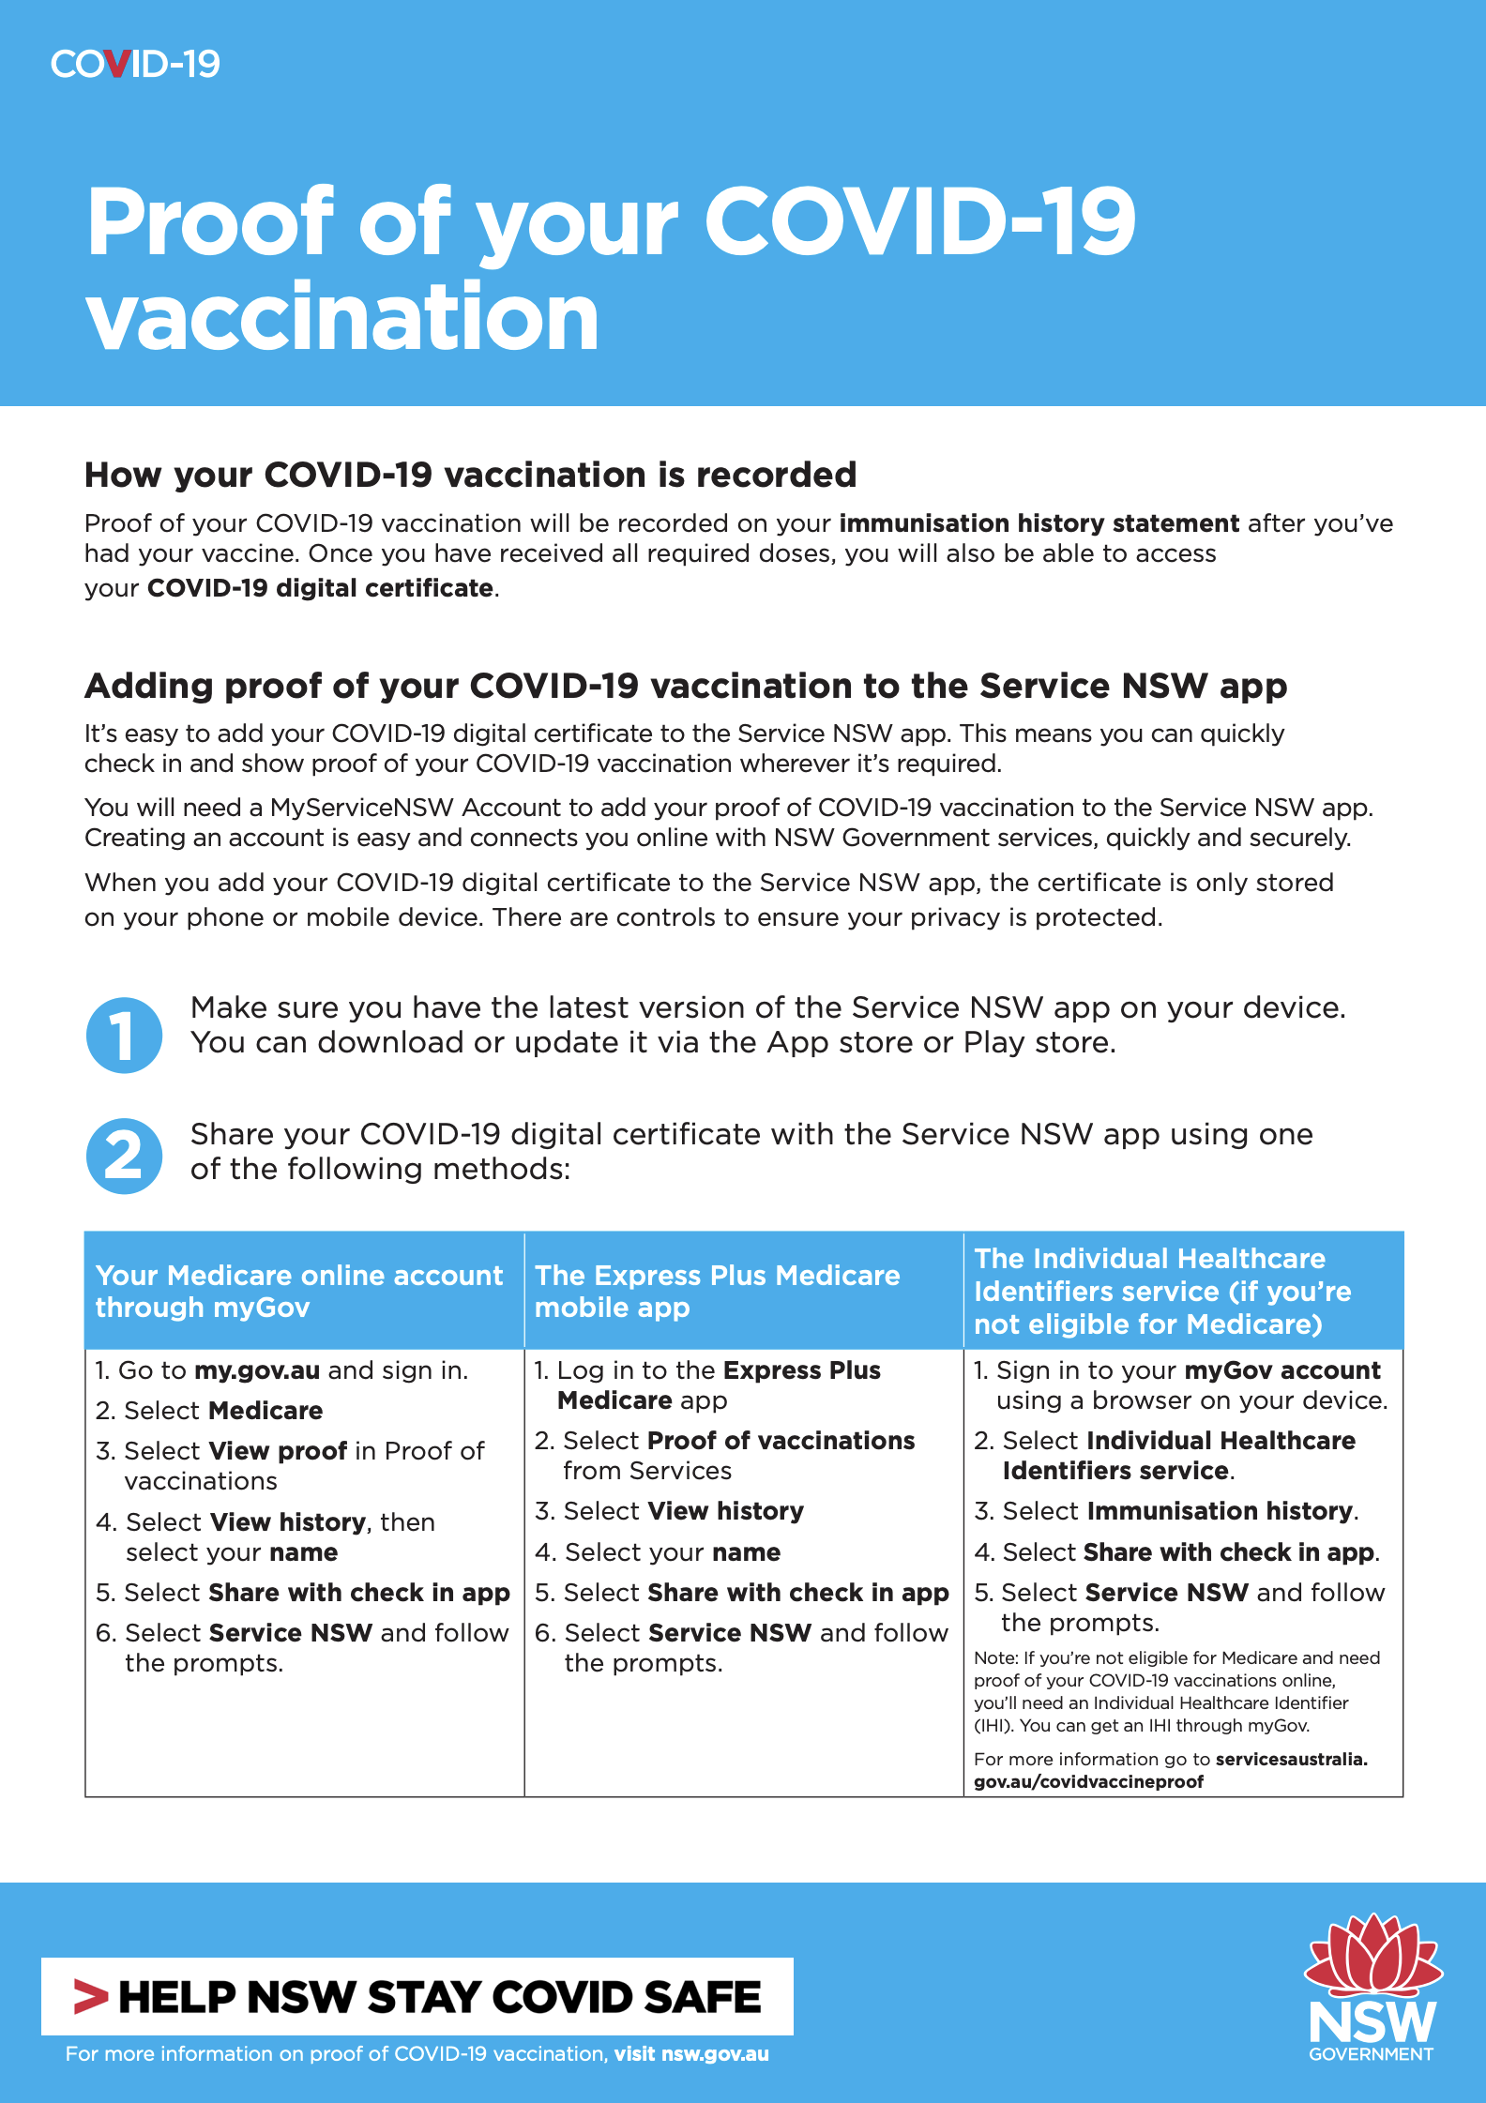
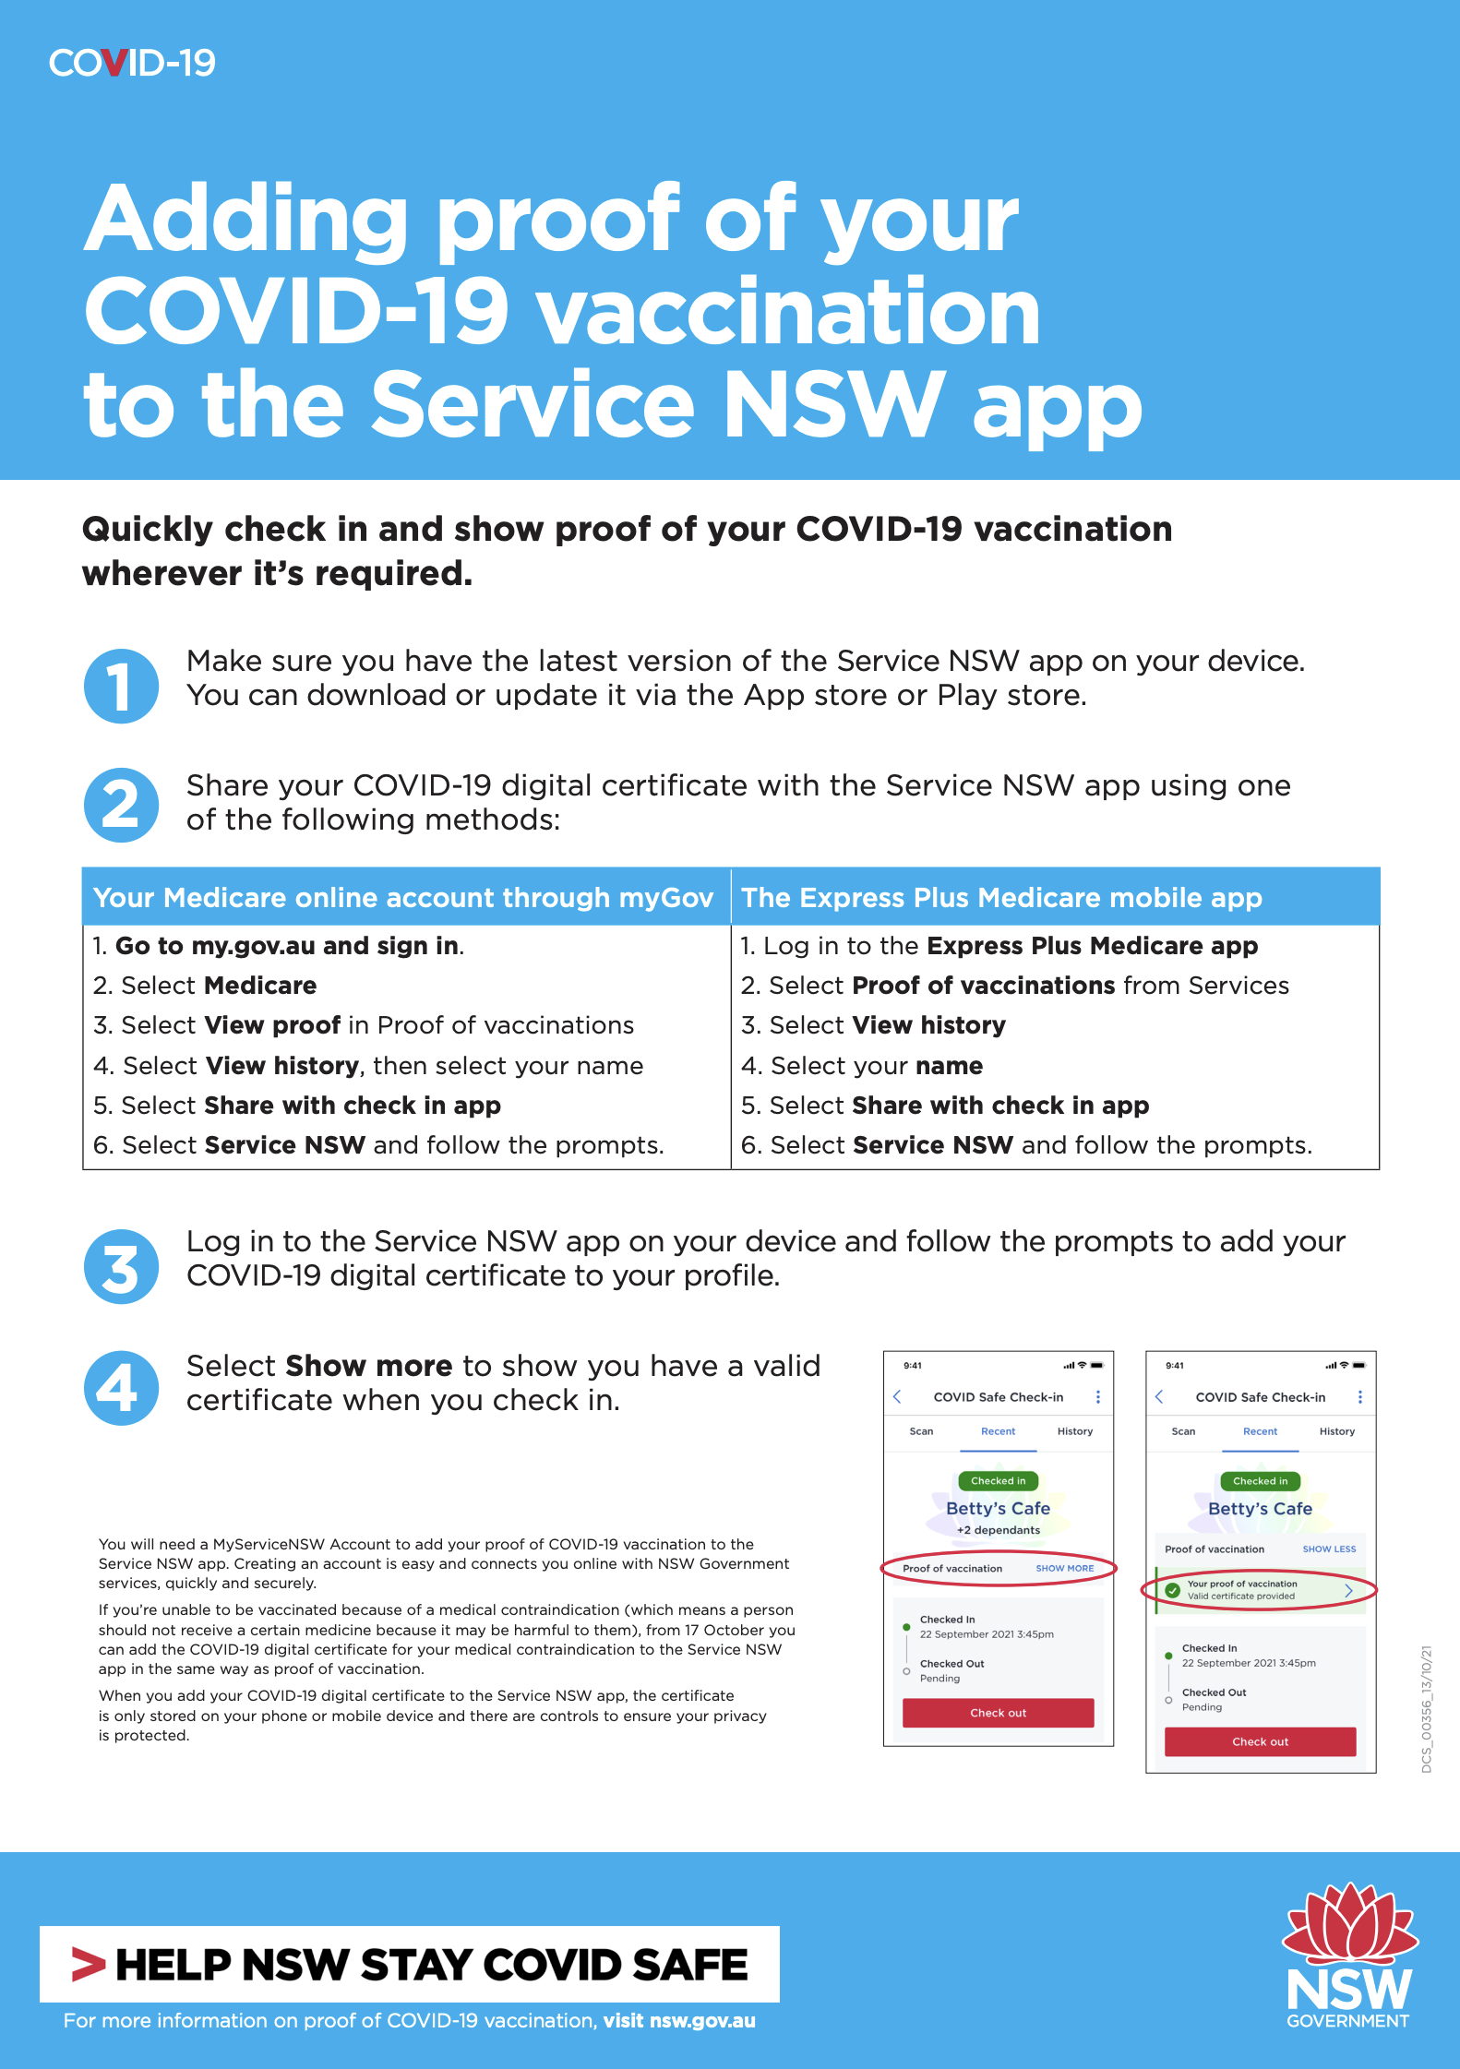
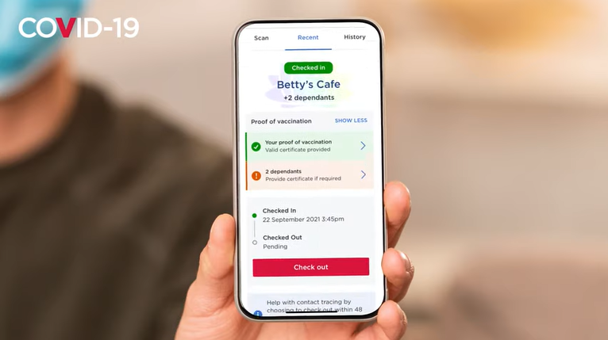
Adding your COVID-19 digital certificate to the Service NSW app
Click here to download flyer (2 pages)
Click here to download poster
Click here to download video
Further information is available online:
Adding proof of your COVID-19 vaccination to the Service NSW app at nsw.gov.au
Privacy Impact Assessment – COVID-19 digital certificate: service.nsw.gov.au

Slide 4
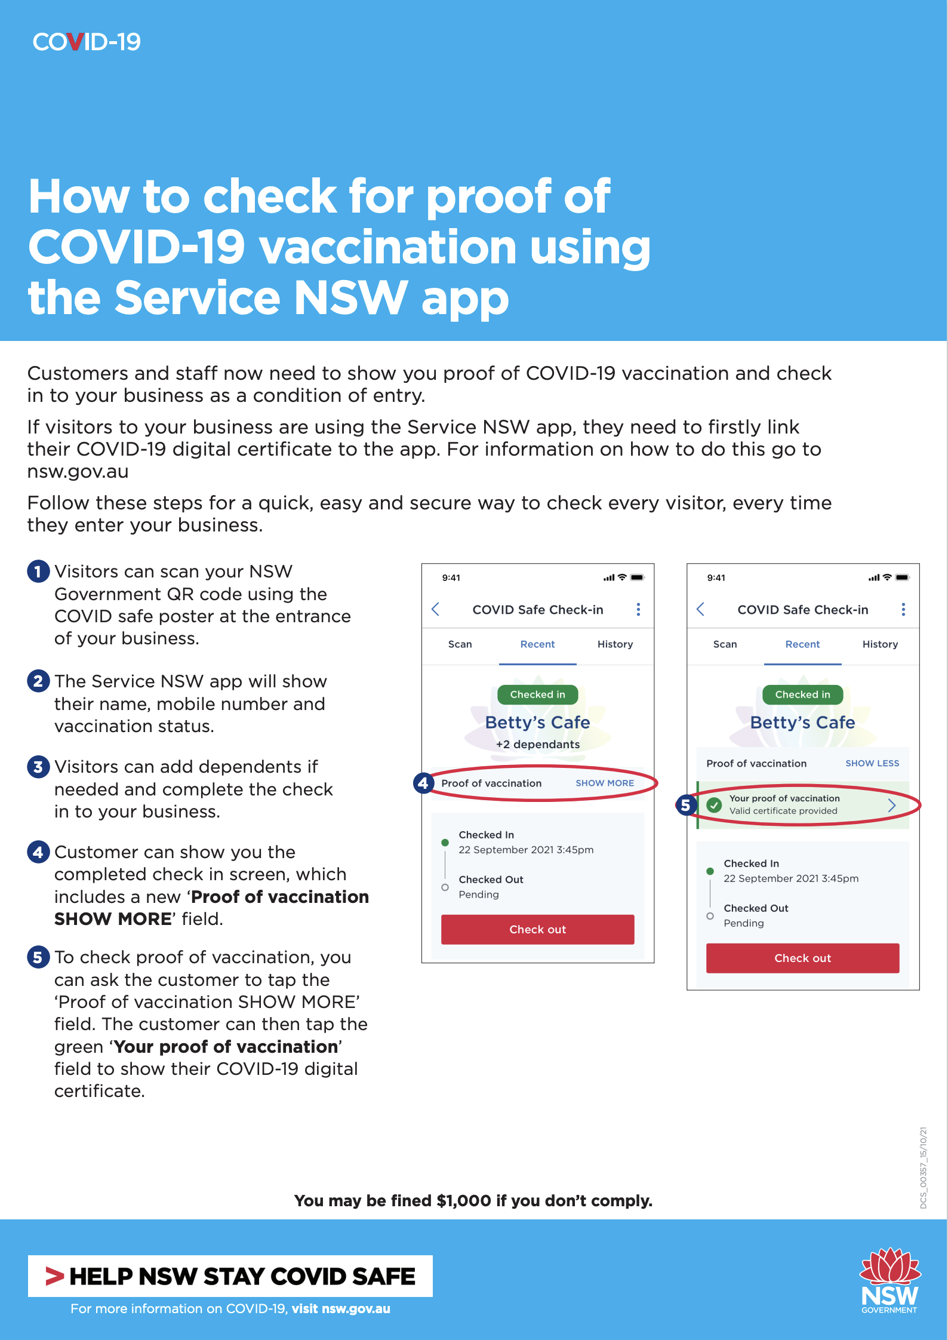
Businesses and venues: how to check for proof of COVID-19 vaccination using the Service NSW app
Click here to download poster

Slide 5
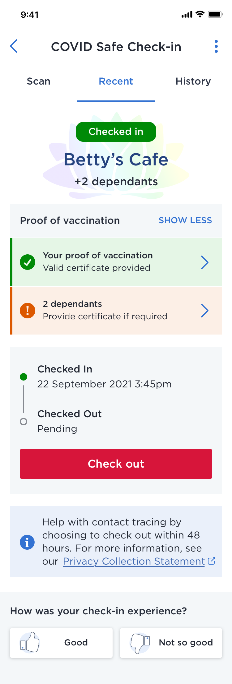
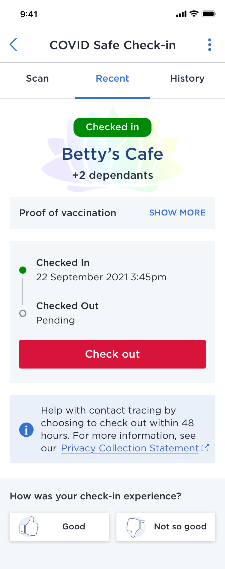
Newsletter/web copy: peak bodies to businesses
Quick and easy proof of COVID-19 vaccination now available on the Service NSW app
As businesses across the state start to reopen, continuing to operate in a COVID safe way is important. This includes having an up-to-date COVID Safety Plan and for some businesses, this will also mean ensuring that employees and patrons are fully vaccinated, or have a vaccine medical contraindication form signed by their doctor, before entering the premises.
To help businesses confirm whether a person is fully vaccinated for COVID-19 quickly and easily, proof of vaccination is now available through the Service NSW app and can be shown as part of a COVID Safe Check-in. Visit nsw.gov.au for details and instructions on adding a COVID-19 digital certificate to the app.
Under the current public health orders, those aged 16 years and over are only permitted to enter certain venues or settings if they are fully vaccinated for COVID-19 or have a medical exemption. In some venues, children under 16 must be accompanied by a fully vaccinated member of their household to enter.
How to check proof of COVID-19 vaccination through the Service NSW app
Your customers and staff can continue to use your existing NSW Government QR code to check in to your business. When someone has added their COVID-19 digital certificate to their Service NSW app, a ‘Proof of vaccination – Show More’ option will automatically appear on the check-in confirmation screen. The individual can then select ‘Show more’ to confirm they have a valid certificate. The COVID-19 digital certificate can also be accessed anytime by the individual on the home screen of the Service NSW app.
Where required, businesses can also use the Service NSW app to verify an individual’s COVID-19 digital certificate. On your app’s home screen, select ‘Check a licence or credential’ and scan the QR code at the bottom of the person’s COVID-19 digital certificate.
After check-in, details of a visit, including if a person was fully vaccinated for COVID-19, will be stored securely with Service NSW for 28 days and will only be shared with NSW Health in the event of a confirmed case to assist with contact tracing.
There are other ways people can show proof of COVID-19 vaccination or medical exemption including:
COVID-19 digital certificate: accessed through the Express Plus Medicare mobile app or Medicare online account through myGov. The COVID-19 digital certificate can be added to a digital wallet, printed or saved offline to a device
Immunisation history statement: accessed through My Health Record, myGov or the Express Plus Medicare app and shared on a smartphone screen or printed
Medical exemption form: COVID-19 digital certificate for medical contraindication (which can be added to the Service NSW app from 17 October), a NSW Health medical contraindication form completed by a registered medical practitioner or a medical clearance notice issued by NSW Health.
Visit nsw.gov.au to learn more about the options to access and share proof of COVID-19 vaccination.

Slide 6
Newsletter/web copy: businesses to staff
Proof of COVID-19 vaccination now available through Service NSW app
As we welcome customers back through our doors it’s important that we continue to operate in a COVID safe way. This means following the public health orders, which includes ensuring our COVID-19 Safety Plan is in place and checking that everyone aged 16 years and over at our premises is fully vaccinated for COVID-19 or has a medical exemption.
To help make checking whether a person is fully vaccinated easier, proof of COVID-19 vaccination can now be shown via the Service NSW app when checking in using the NSW Government QR code.
How to link your COVID-19 digital certificate to the Service NSW app
Ensure you have a MyServiceNSW Account and the latest version of the Service NSW app. Please also ensure Medicare is linked to your myGov account.
Share your COVID-19 digital certificate with the Service NSW app via your Medicare online account through myGov, the Express Plus Medicare mobile app or the Individual Healthcare Identifiers service (if you’re not eligible for Medicare).
Log in to the Service NSW app on your device and follow the prompts to add your COVID-19 digital certificate to your profile.
Detailed instructions can be found at nsw.gov.au.
How to check proof of COVID-19 vaccination through the Service NSW app
If someone has added their COVID-19 digital certificate to their Service NSW app, a ‘Proof of vaccination – Show More’ option will automatically appear on the check-in confirmation screen. You can then ask the person to select ‘Show more’ to show they have a valid certificate. An individual can access their COVID-19 digital certificate anytime on the home screen of the Service NSW app.
Importantly, proof of COVID-19 vaccination or medical exemption can still be confirmed in other ways. This includes:
COVID-19 digital certificate: accessed via the Express Plus Medicare mobile app or Medicare online account (through myGov) and added to a digital wallet, printed or saved offline to a device
Immunisation history statement: accessed through My Health Record, myGov or the Express Plus Medicare app and shared on a smartphone screen or printed
Medical exemption form: COVID-19 digital certificate for medical contraindication (which can be added to the Service NSW app from 17 October), a NSW Health medical contraindication form completed by a registered medical practitioner or a medical clearance notice issued by NSW Health.
Thank you for your support in continuing to keep our business COVID safe and our doors open.
Click here to download poster

Slide 7
Newsletter/web copy: businesses to customers
Proof of COVID-19 vaccination can now be provided through the Service NSW app
To comply with the current public health orders, our business is required to ensure that anyone aged 16 and over is fully vaccinated for COVID-19 (or has a medical exemption) to enter our premises. Our team is doing their best to make this process as seamless as possible, so you can make the most of your time visiting us.
As a COVID Safe business, we will now be able to check your proof of COVID-19 vaccination during your regular NSW Government QR code check-in. All you need to do is add your COVID-19 digital certificate to the Service NSW app before you visit. You can find out how at nsw.gov.au
Then when you arrive it is quick and easy. Check in with the QR code as usual and a ‘Proof of vaccination – Show more’ option will appear automatically on the check-in confirmation screen. Select ‘Show more’ to show you have a valid certificate when you check in.
Alternatively, there are other ways you can show your proof of vaccination or medical exemption:
COVID-19 digital certificate: access through the Express Plus Medicare mobile app or Medicare online account through myGov. The COVID-19 digital certificate can be added to a digital wallet, printed or saved offline to a device
Immunisation history statement: access through My Health Record, myGov or the Express Plus Medicare app and share on a smartphone screen. You can also bring a printed copy of your statement.
Medical exemption form: COVID-19 digital certificate for medical contraindication (which can be added to the Service NSW app from 17 October), an NSW Health medical contraindication form completed by a registered medical practitioner, or a medical clearance notice issued by NSW Health.
Thank you for your patience and support in helping to keep our business open and COVID safe. We look forward to seeing you soon.
Click here to download poster

Slide 8
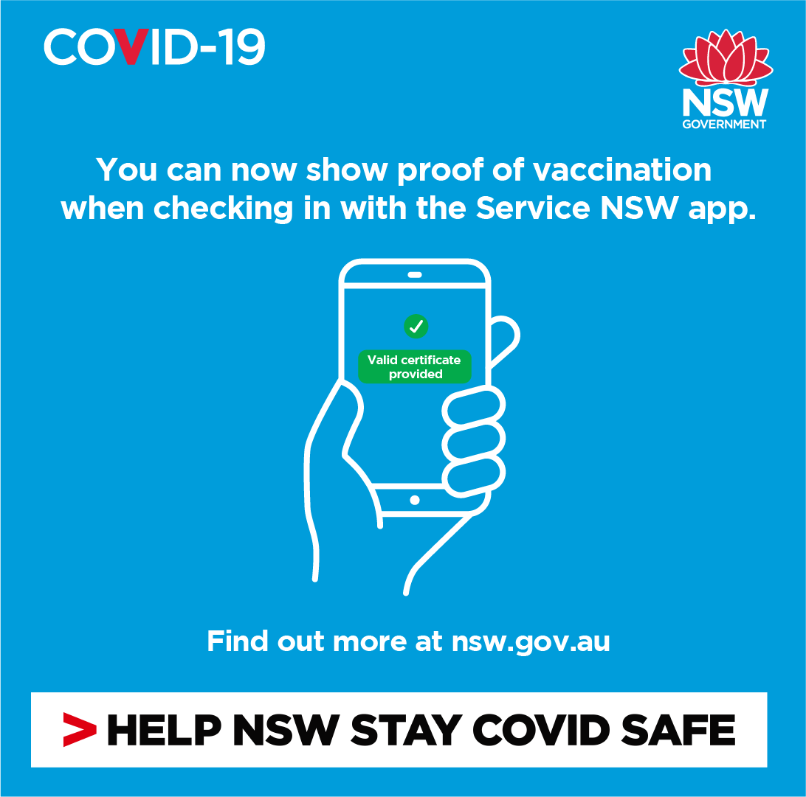
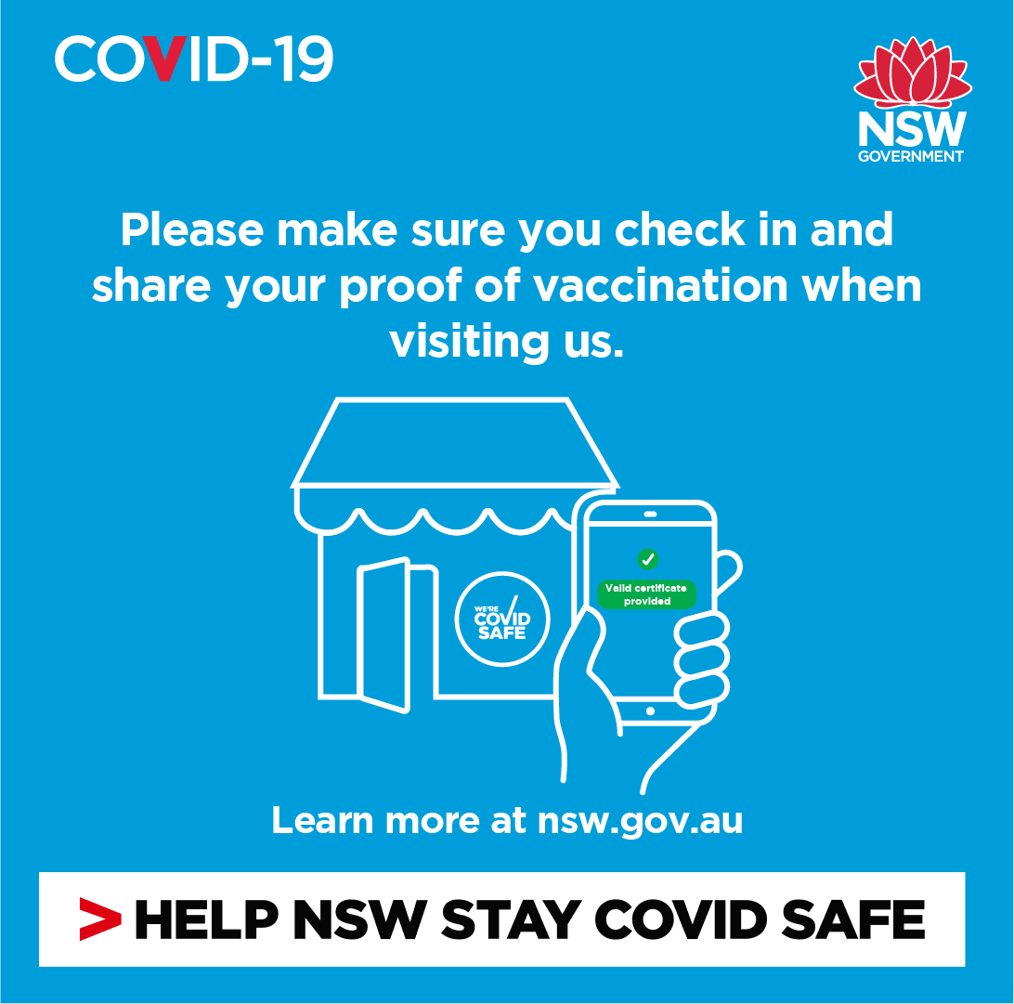
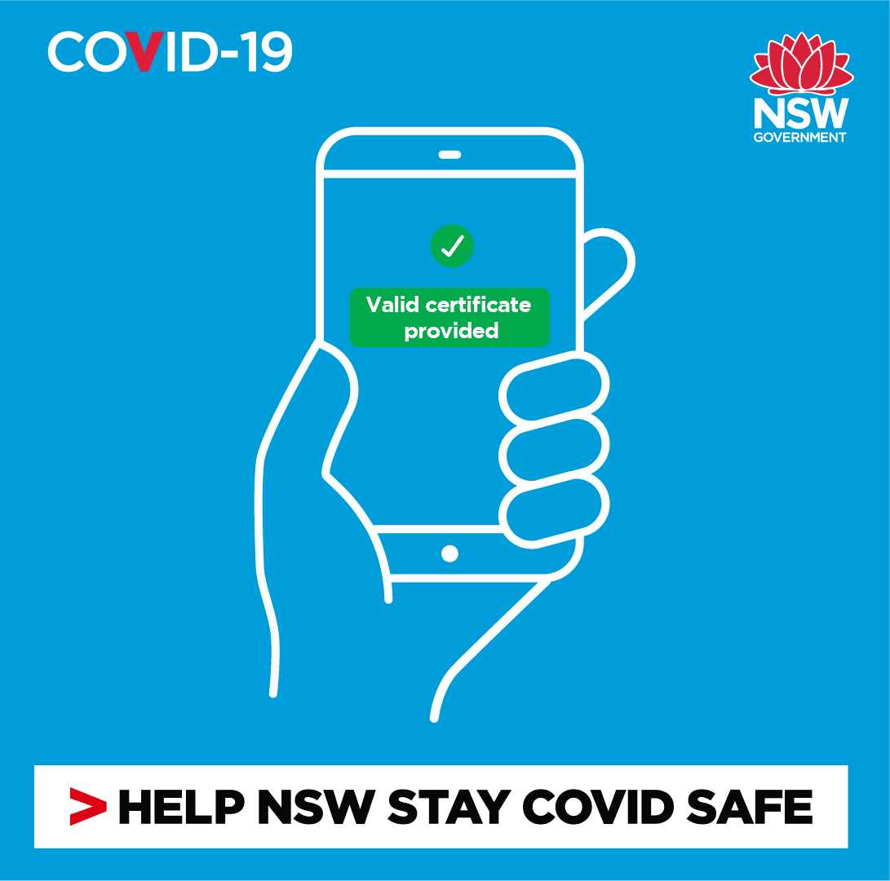
Business to customers: social content
To download, right click on tile and select ‘Save as picture’ or click the link above each image for a higher resolution version
Click here to download high res image
Click here to download high res image
Click here to download high res image
Post: Add your COVID-19 digital certificate to your Service NSW app and show your proof of vaccination quickly and easily when you check in to our business. Learn more at nsw.gov.au
Post: Showing proof of COVID-19 vaccination is a condition of entry for our business. One way you can show this proof is on the Service NSW app when checking in. It’s quick and easy. Learn more at nsw.gov.au
Post: You will need to show your proof of COVID-19 vaccination when you visit us. One way you can show this proof is on the Service NSW app when checking in. It’s quick and easy. Learn more at nsw.gov.au

Slide 9
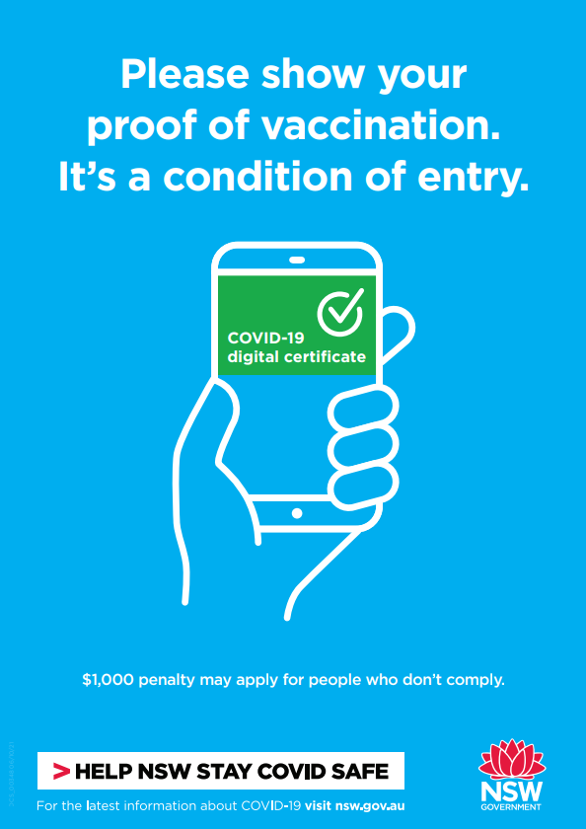
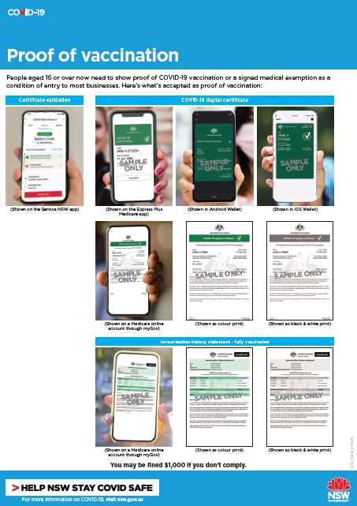
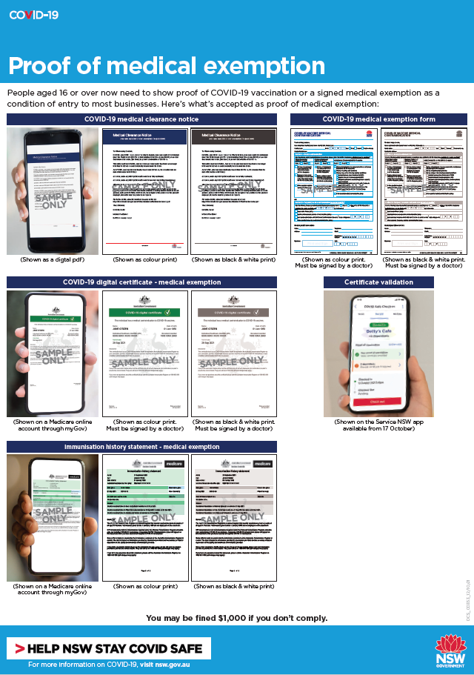
Business to customers: posters
Printer friendly versions available. Additional COVID safe collateral is available at nsw.gov.au
Click here to download poster
Click here to download poster
Click here to download poster

Slide 10
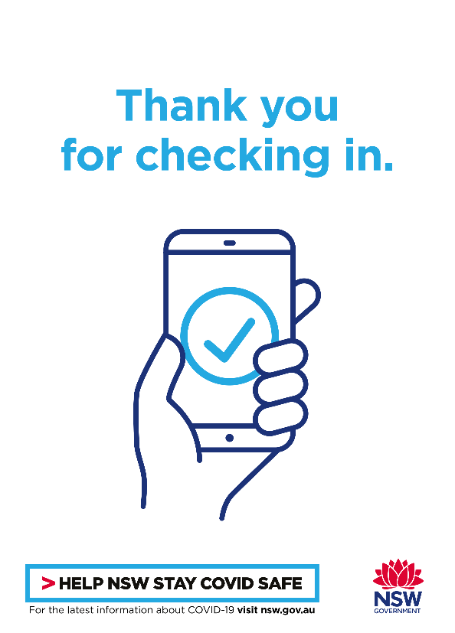
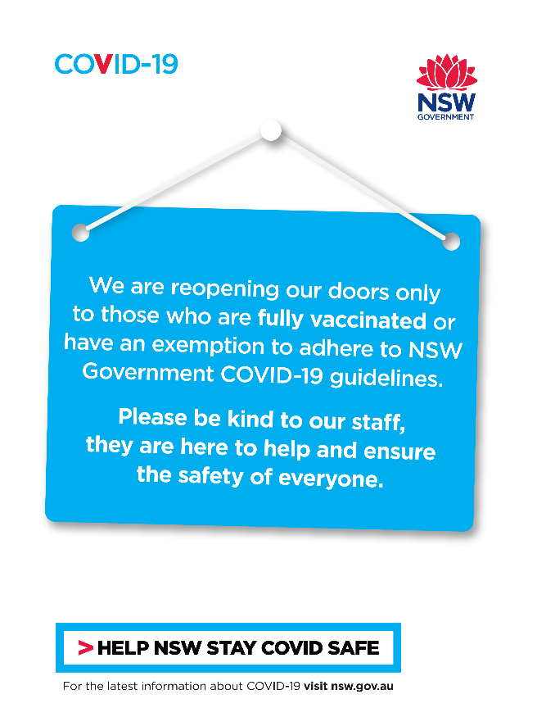
Business to customers: posters
Printer friendly versions available. Additional COVID safe collateral is available at nsw.gov.au
Click here to download poster
Click here to download posters

Slide 11
Privacy information
We respect your privacy
The Service NSW app will send an individual’s information to NSW Health only when required for the purpose of contact tracing. No personal information will be shared with a venue. Details of your visit plus whether you are fully vaccinated for COVID-19 (if available) are stored securely with Service NSW for 28 days and will be shared with NSW Health only in the event of a confirmed case to assist in contact tracing.​
For more information on how the Service NSW app uses this information, please visit https://www.service.nsw.gov.au/privacy-impact-assessment-covid-19-digital-certificate.
You can also view our privacy collection statement at https://www.service.nsw.gov.au/covid-safe-check-privacy-collection-statement.

